Slide 1
Analytical strategies for deciphering transcriptomics

Slide 2
Overview of the dataset
Transcriptomic profiles from sorted Teff and Treg cells at 6 timepoints

Slide 3
Overview of the dataset
Transcriptomic profiles from sorted Teff and Treg cells at 6 timepoints

Slide 4
Aims of the transcriptomic analyses
Understand the biology of the IL2 treatment over time
What are the key genes impacted by the treatment ?
What are the main signaling pathways impacted by the treatment ?
Identify biomarkers of the response to IL2 treatment
What genes expressed on not at baseline can predict the response status of the patients ?
Discover gene associated with the clinical outcomes
What transcripts are associated with biological outcomes ?
Novel transcripts are associated with biological outcomes ?

Slide 5
Aims of the transcriptomic analyses
Identify biomarkers of the IL2 response at baseline in Teff and Treg
Identify genes and pathways impacted by the IL2 treatment in Teff and Treg overtime
Detect gene isoforms specific to patients' responses

Slide 6
1 – Quality control and outliers' identification

Slide 7
1 – Identify biomarkers of the IL2 response at baseline in Teff and Treg
Perform differential expression analyses to identify genes with expressions different between responders and non-responders
Based on DESeq2
MDS representations to visualize sample heterogeneity
Perform functional enrichment analyses to associate these gene signatures with signaling pathways and biological functions
Based on GSEA, GO, EnrichR, stringDB (querying ~170 databases)
Based on our own gene signatures derived from the lab and the literature
Based on the ICA-GSEA method (Phuong’s works)

Slide 8
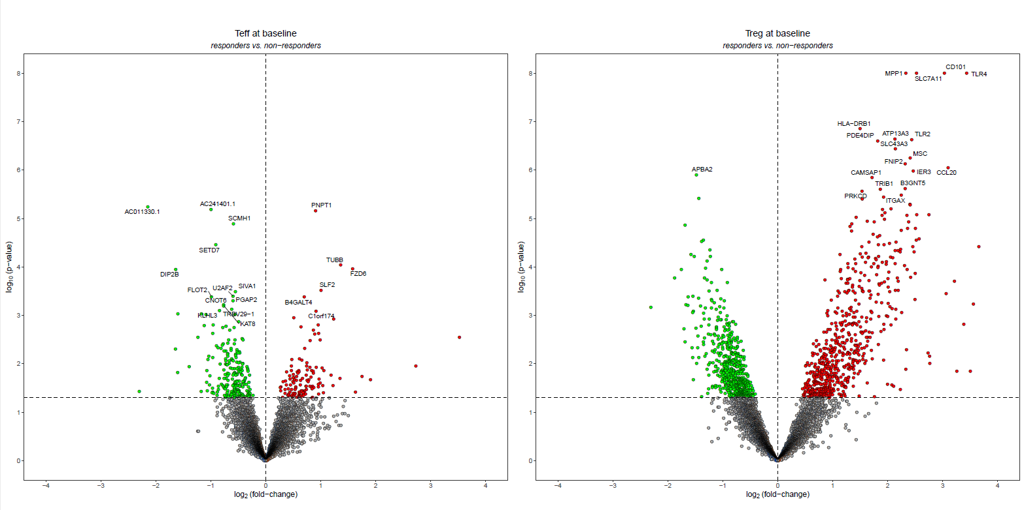
1 – Identify biomarkers of the IL2 response at baseline in Teff and Treg

Slide 9
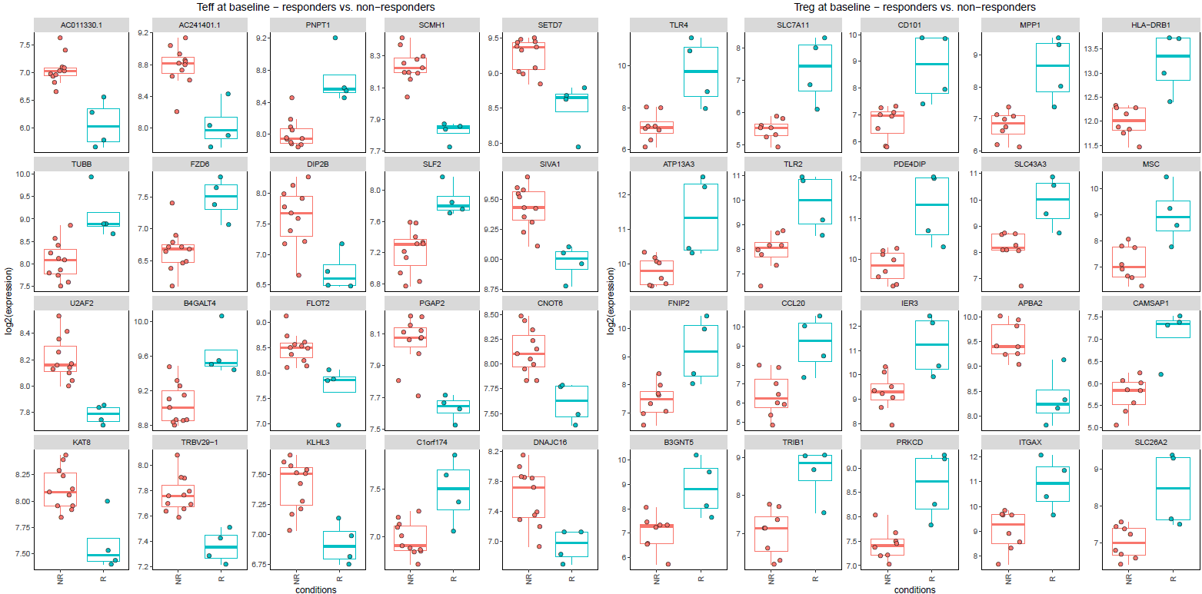
1 – Identify biomarkers of the IL2 response at baseline in Teff and Treg

Slide 10
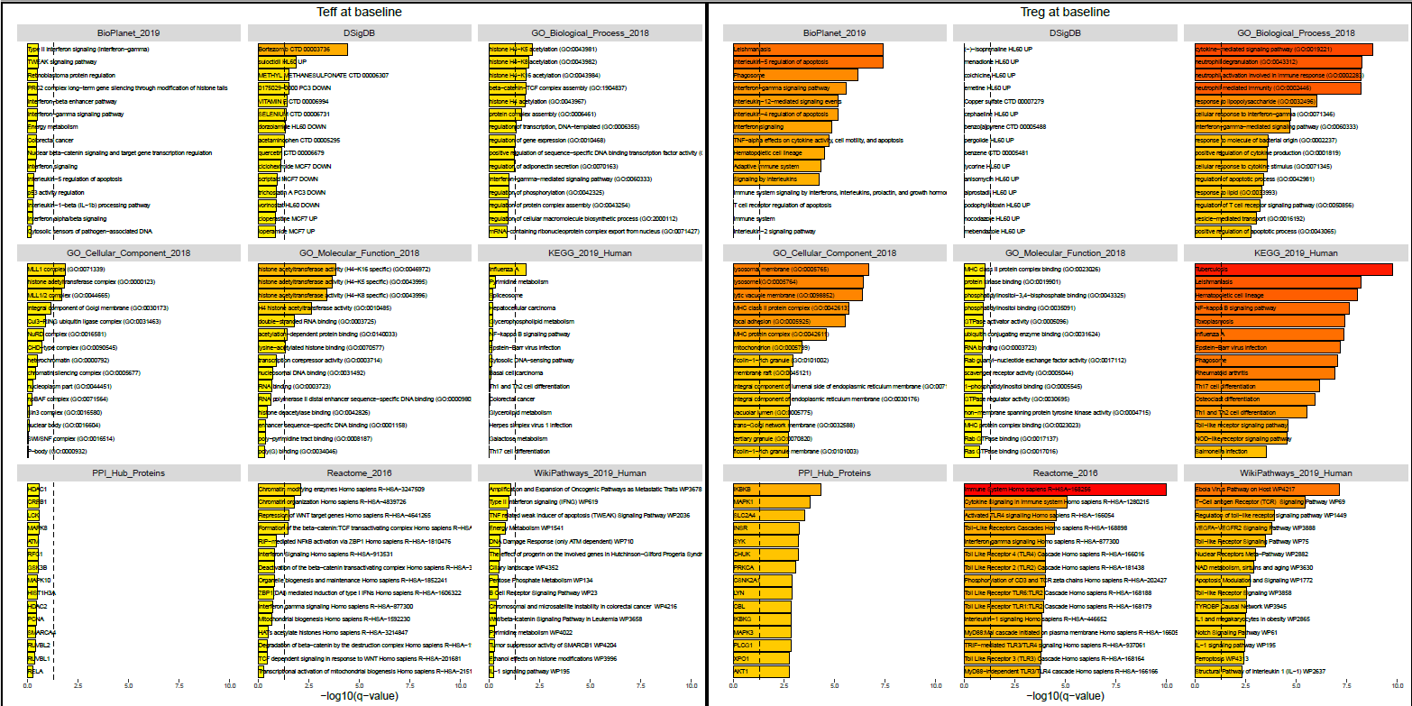
1 – Identify biomarkers of the IL2 response at baseline in Teff and Treg

Slide 11
2 – Identify genes and pathways impacted by the IL2 treatment in Teff and Treg
Perform differential expression analyses to identify genes with expressions different between responders and non-responders
Based on DESeq2
MDS representations to visualize sample heterogeneity
Perform functional enrichment analyses to associate these gene signatures with signaling pathways and biological functions
Based on GSEA, GO, EnrichR, stringDB (querying ~170 databases)
Based on our own gene signatures derived from the lab and the literature
Based on the ICA-GSEA method (Phuong’s works)

Slide 12
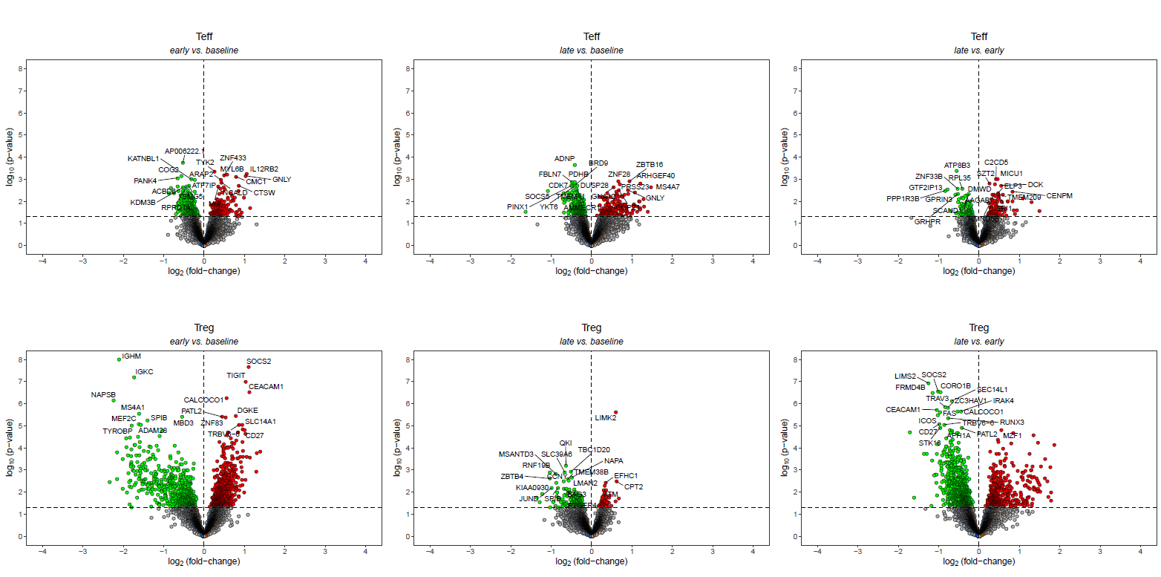
2 – Identify genes and pathways impacted by the IL2 treatment in Teff and Treg

Slide 13
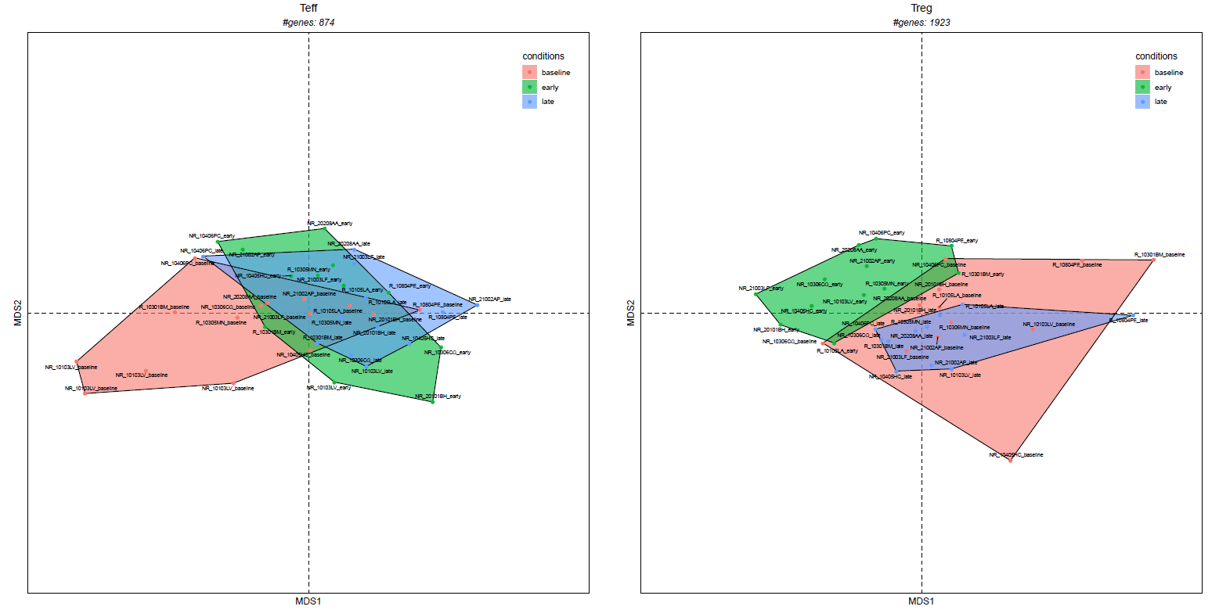
2 – Identify genes and pathways impacted by the IL2 treatment in Teff and Treg

Slide 14
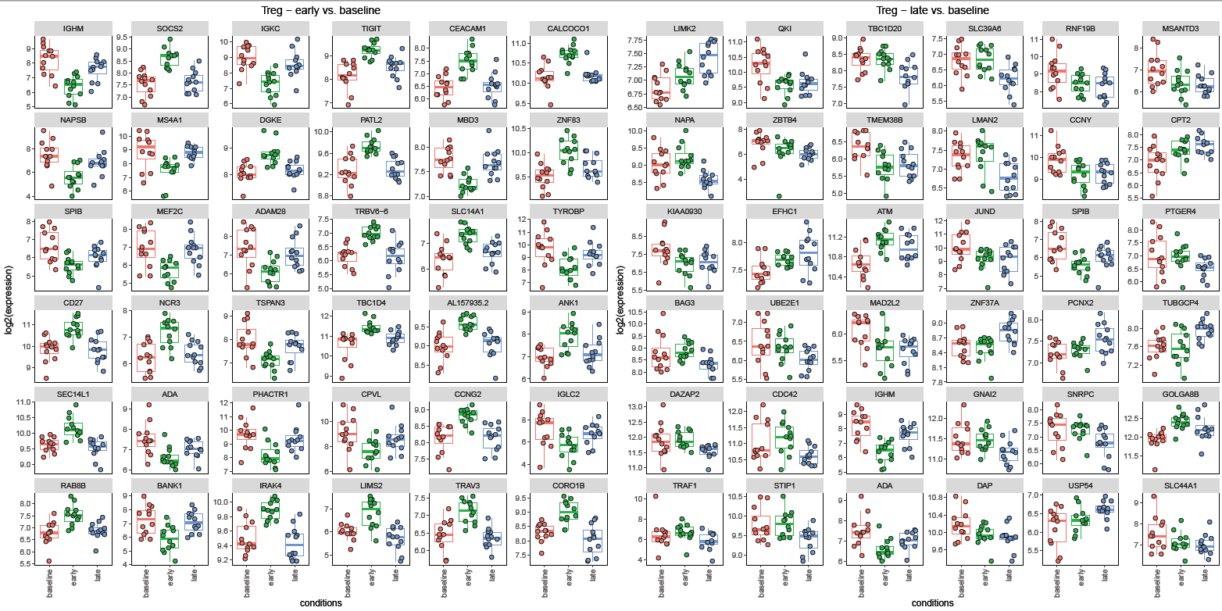
2 – Identify genes and pathways impacted by the IL2 treatment in Teff and Treg

Slide 15
2 – Identify genes and pathways impacted by the IL2 treatment in Teff and Treg

Slide 16
2 – Identify genes and pathways impacted by the IL2 treatment in Teff and Treg

Slide 17
3 – Generate and analyze gene co-expression networks
Generation of gene co-expression networks

Slide 18
3 – Generate and analyze gene co-expression networks
Generation of gene co-expression networks

Slide 19
3 – Generate and analyze gene co-expression networks
Generation of gene co-expression networks

Slide 20
3 – Generate and analyze gene co-expression networks
Generation of gene co-expression networks using the WGCNA
1 network for Teff samples from placebo patients
1 network for Teff samples from IL2-treated patients
1 network for Treg samples from placebo patients
1 network for Treg samples from IL2-treated patients
Topological analyses to decipher immune systems
Identify communities of genes having similar expression patterns overtime
Identify hubs and bottlenecks

Slide 21
3 – Generate and analyze gene co-expression networks
Generation of gene co-expression networks using the WGCNA
1 network for Teff samples from placebo patients
1 network for Teff samples from IL2-treated patients
1 network for Treg samples from placebo patients
1 network for Treg samples from IL2-treated patients
Systematic analysis of gene co-expression modules
Determine the module kinetics
Identify PPI hubs
Associations with clinical data using ML approaches (regression, LDA, …)
Functional enrichment analysis using ~170 databases

Slide 22
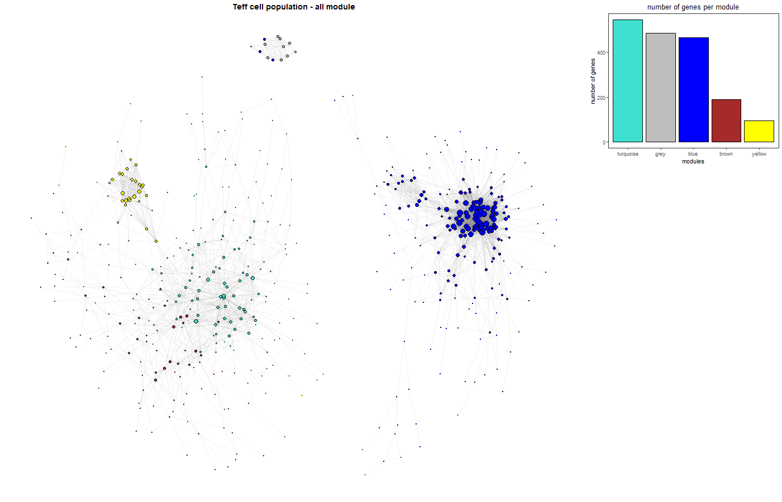
3 – Generate and analyze gene co-expression networks
Teff network
4 modules identified

Slide 23
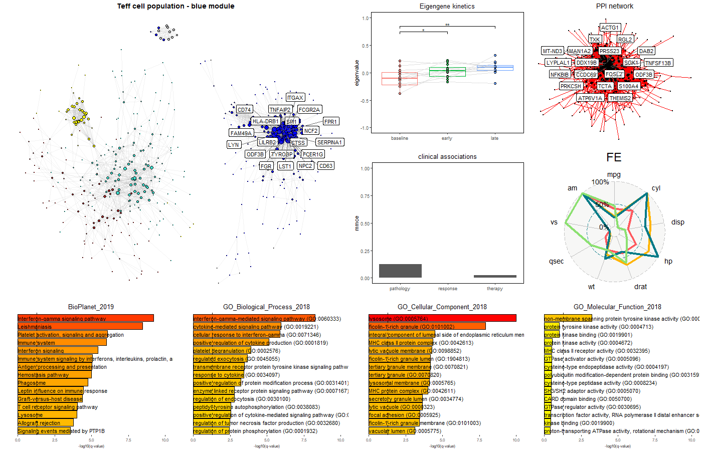
3 – Generate and analyze gene co-expression networks
Teff network blue module
module associated with inflammation

Slide 24
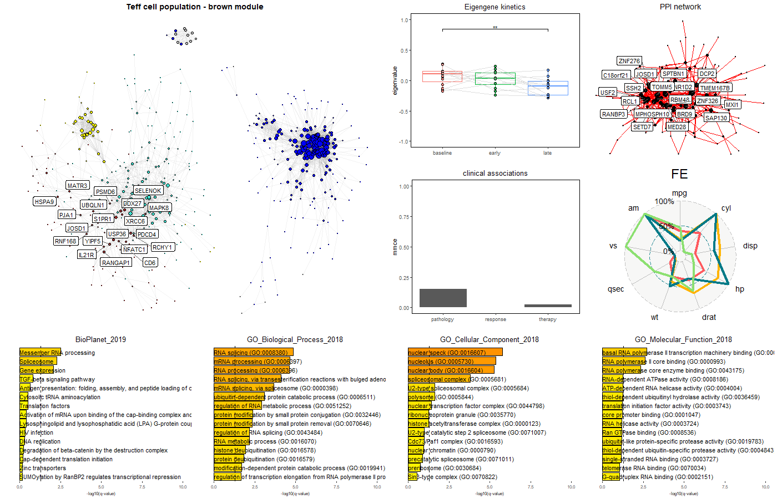
3 – Generate and analyze gene co-expression networks
Teff network brown module
module associated with RNA-processing

Slide 25
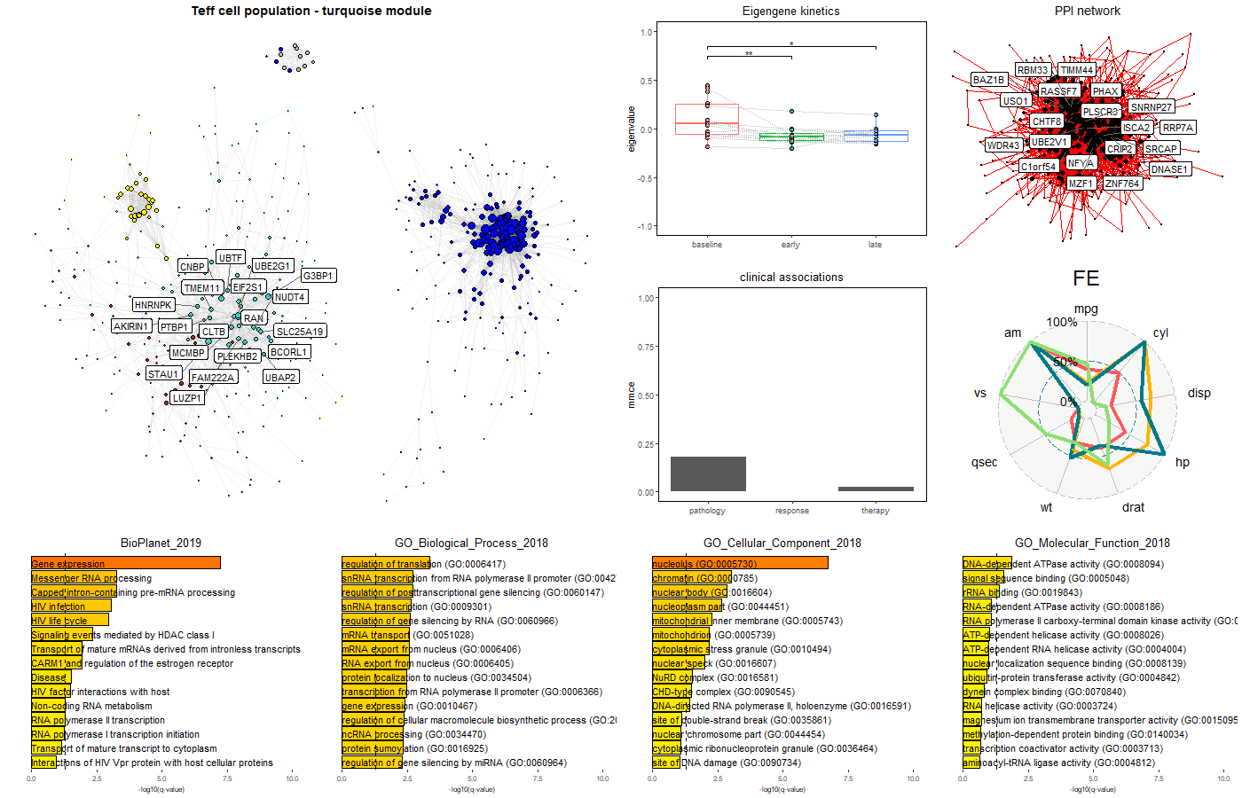
3 – Generate and analyze gene co-expression networks
Teff network turquoise module
module associated to gene expression mechanisms

Slide 26
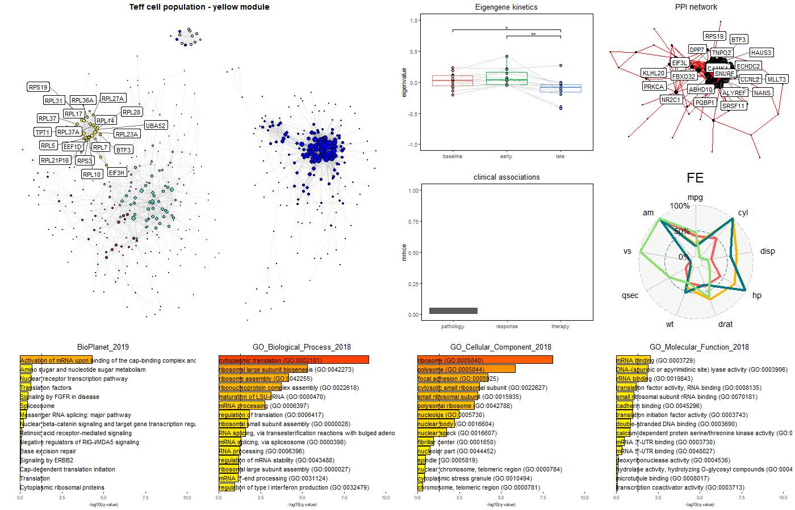
3 – Generate and analyze gene co-expression networks
Teff network yellow module
module associated to gene ribosomal mechanisms

Slide 27
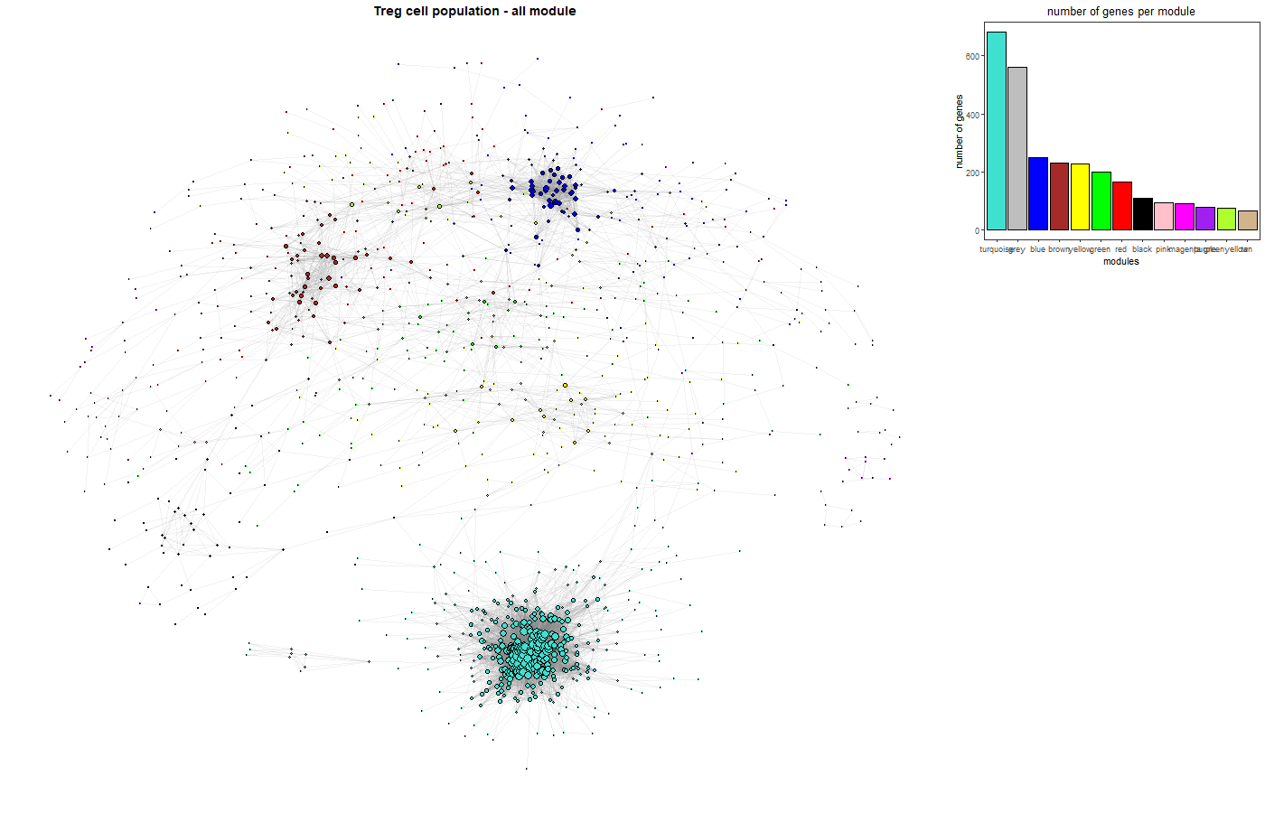
3 – Generate and analyze gene co-expression networks
Treg network
12 modules identified

Slide 28
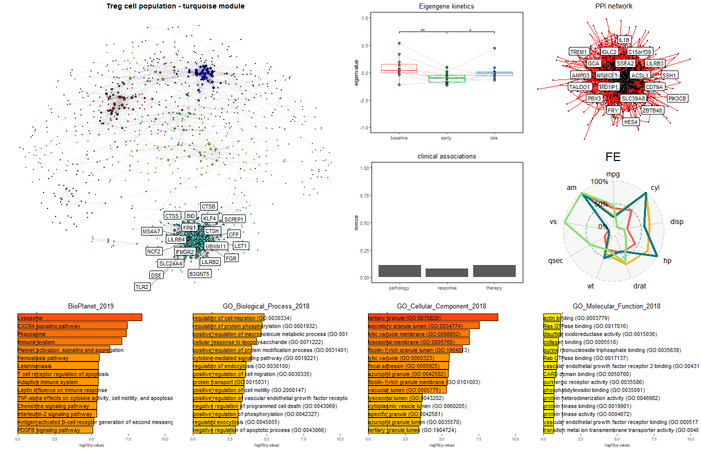
3 – Generate and analyze gene co-expression networks
Treg network turquoise module
module associated to chemo-attraction mechanisms

Slide 29
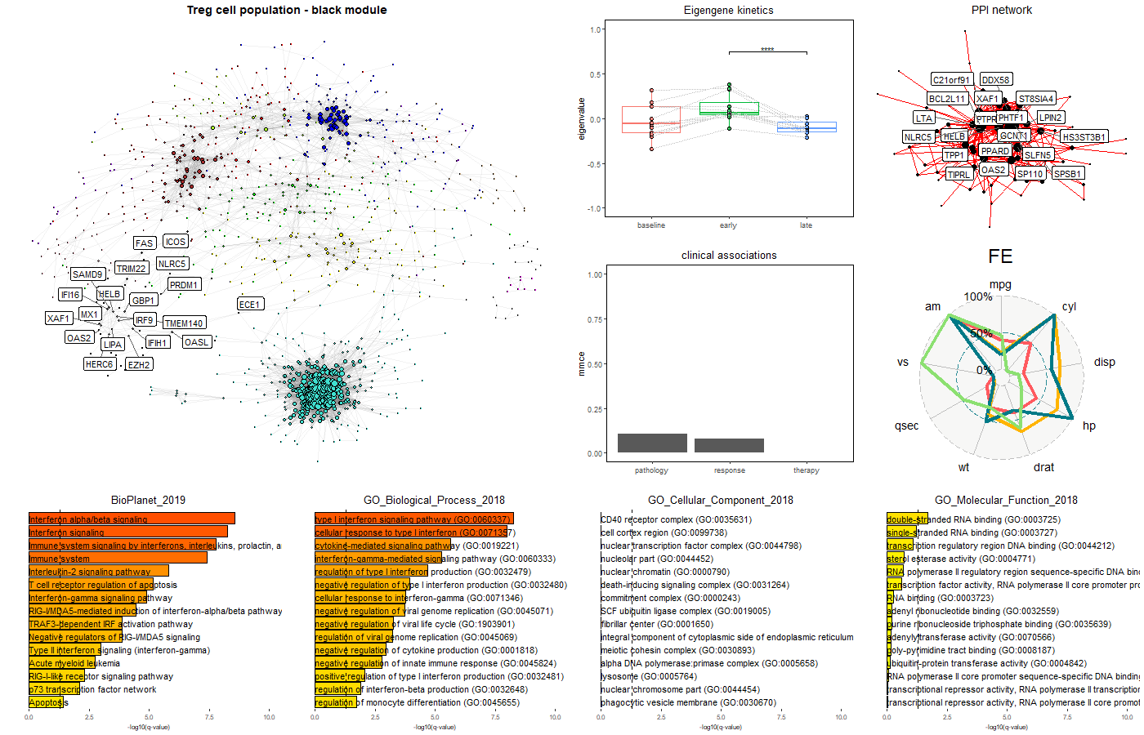
3 – Generate and analyze gene co-expression networks
Treg network black module
module associated to inflammation mechanisms

Slide 30
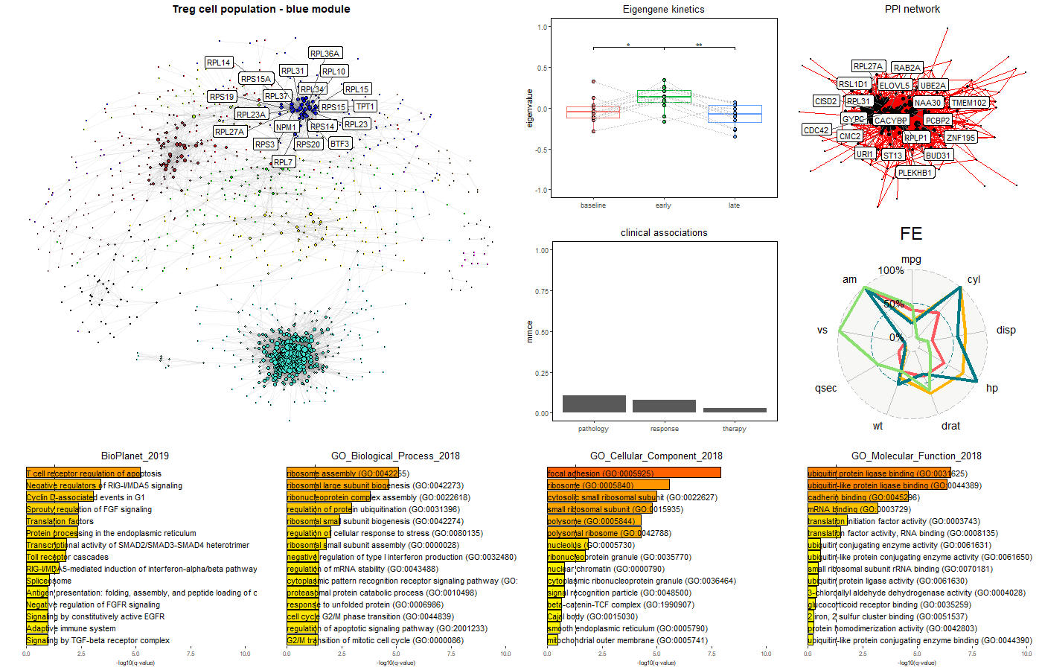
3 – Generate and analyze gene co-expression networks
Treg network blue module
module associated to gene ribosomal mechanisms

Slide 31
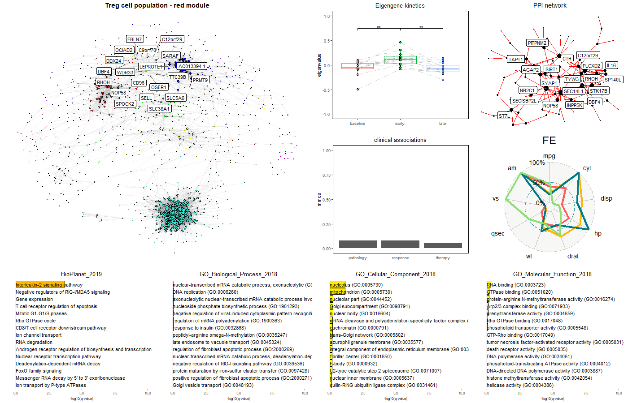
3 – Generate and analyze gene co-expression networks
Treg network red module
module associated to IL2 mechanisms

Slide 32
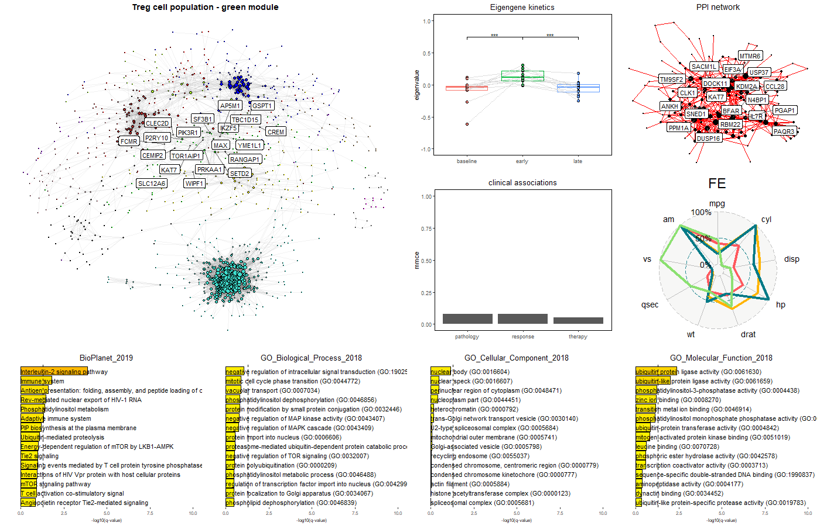
3 – Generate and analyze gene co-expression networks
Treg network green module
module associated to IL2 mechanisms

Slide 33
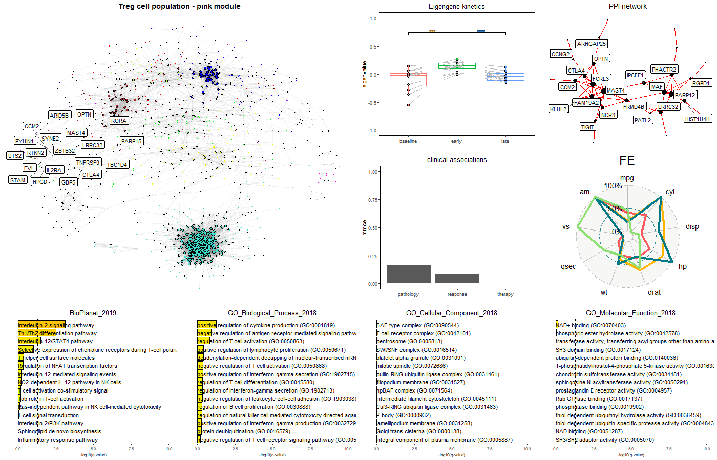
3 – Generate and analyze gene co-expression networks
Treg network pink module
module associated to IL2 mechanisms

Slide 34
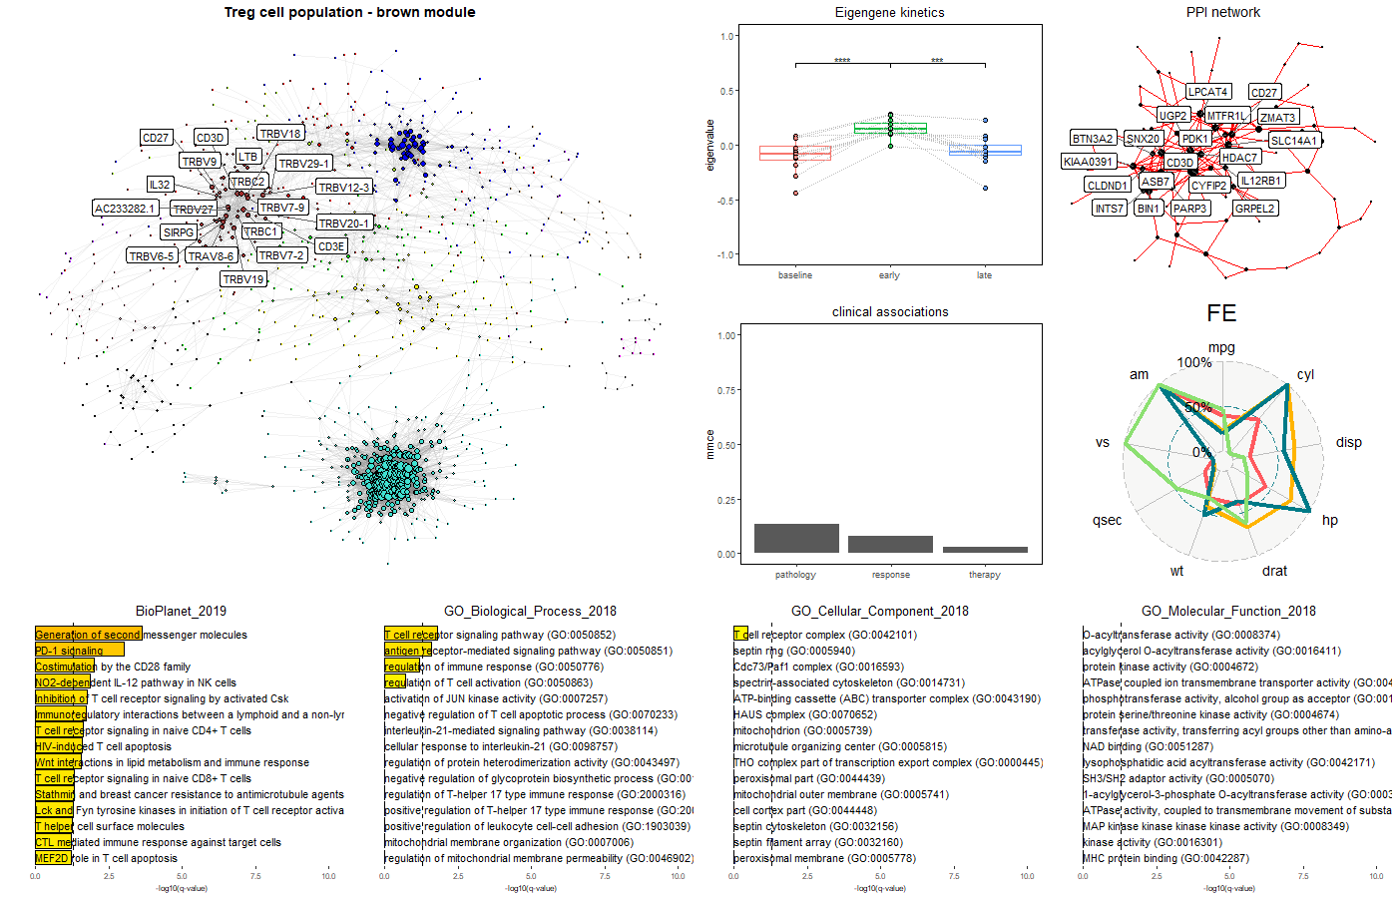
3 – Generate and analyze gene co-expression networks
Treg network brown module
module associated to T-cell mechanisms

Slide 35
4 – Detect gene isoforms specific to patients' responses
Can we detect gene isoforms (transcripts) associated with the patient’s responses (responders vs. non-responders) ?
In terms of isoform expression
In terms of isoform usage
Analysis based on the IsoformSwitchAnalyseR package
Detect isoform switches via DEXseq
Analysis of individual isoform switching
By combining or not Teff and Treg profiles

Slide 36
4 – Detect gene isoforms specific to patients' responses
Using both Teff and Treg samples
CSGALNACT1
GOLGA8A
HLA-B
MXD1

Slide 37
4 – Detect gene isoforms specific to patients' responses
Using both Teff and Treg samples
CSGALNACT1
GOLGA8A
HLA-B
MXD1

Slide 38
4 – Detect gene isoforms specific to patients' responses
restricted to Treg samples
HLA-DQB1
GP6
C1R
MXD1

Slide 39
4 – Detect gene isoforms specific to patients' responses
restricted to Treg samples
HLA-DQB1
GP6
C1R
MXD1

